Slide 1
Laravel vs
CodeIgniter
Tymo de Kock

Slide 2
What we’ll look at
Installations
Benchmarking
Comparisons
Conclusions

Slide 3
Step One: Installation

Slide 4
CodeIgniter - Installation
Download package
Unzip in folders
Upload to server
Adjust config.php
Adjust database.php
NO CLI
NO INSTALLER

Slide 5
Laravel - Installation
Use Composer
Add to PATH
Laravel new <project>
Prerequisites: Apache
Homestead possible
Lots more documentation
CLI
Easy dependency management with composer

Slide 6
Benchmarking

Slide 7
Benchmark Specs
Laravel
Laravel 5.4 demo application
Cloudways Managed DigitalOcean server : 8GB
PHP 7.0
Test Duration: 5 min
No of Users: 250
CodeIgniter
Cloudways Managed Linode server : 2GB
Datacenter: Bangalore
PHP 7.0
No caching libraries
No of Users: 50, Requests 500-1000
Codeigniter 3.x with PHP 7.0

Slide 8
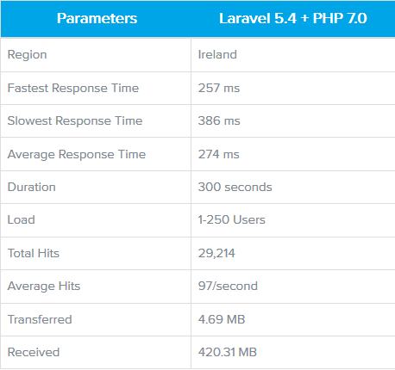
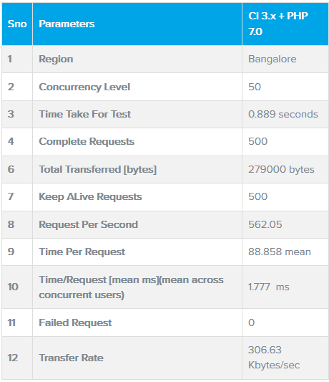
Benchmark Results

Slide 9
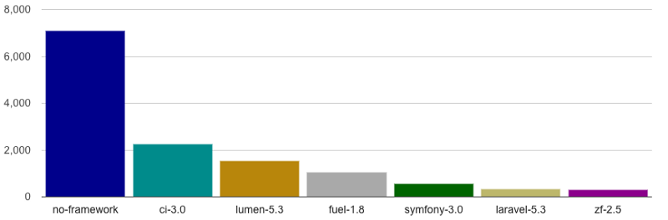
Comparisons - Requests Per Seconds
(Higher is better)

Slide 10
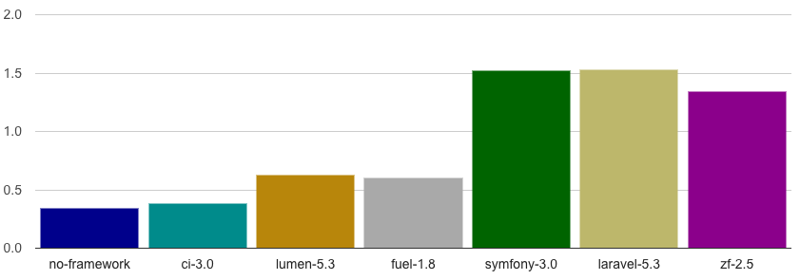
Comparisons - Memory Usage
(Lower is better)

Slide 11
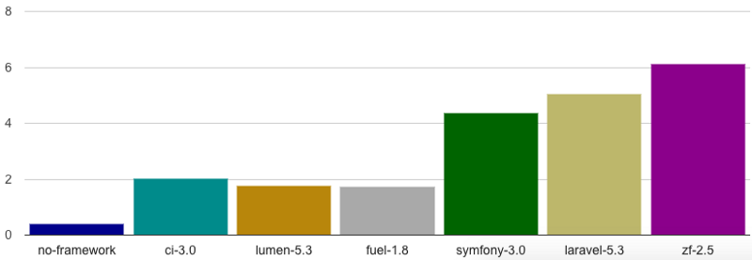
Comparisons - Execution Time
(Lower is better)

Slide 12
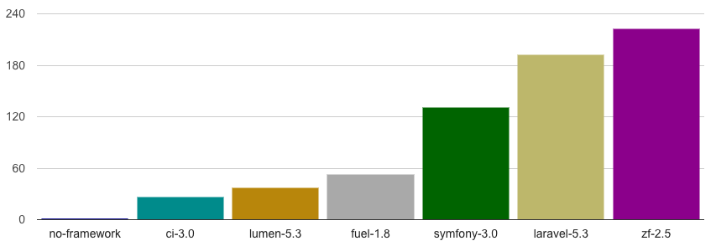
Comparisons - Included Files
(Lower is better)

Slide 13
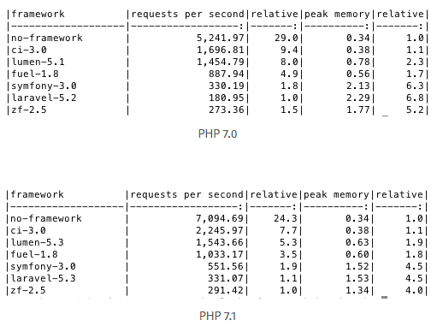
Comparisons - PHP versions

Slide 14
Conclusies
CodeIgniter more light-weight
Less features, but more about this later
Laravel is getting better at managing its resources as it evolves

Slide 15
Features
Laravel CodeIgniter
ORM: Yes
Packaged Module: Yes
Inbuilt user Auth: Yes
Inbuilt Captcha: No
Templating Engine: Blade
Code generator: Yes
Namespaces: Yes
Inbuilt CLI: Yes
Log management: Yes
And more
ORM: No
Packaged Module: No
Inbuilt user Auth: No
Inbuilt Captcha: Yes
Templating Engine: Php proprietary
Code generator: No
Namespaces: No
Inbuilt CLI: No
Log management: Yes

Slide 16
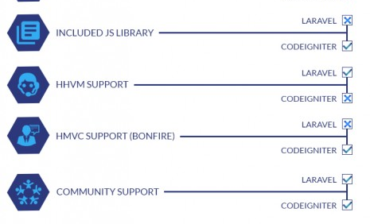

Slide 17
Some further conclusions
Laravel seems to be more meaty
A bit more complex than CodeIgniter, however
More features, more complexity
Laravel has more quality-of-life options
Database management is easier with Laravel and it’s ORM
CodeIgniter is good for beginners
CodeIgniter is a lot faster and compact

Slide 18
Final Conclusion
CodeIgniter is for smaller systems, easier to maintain and a lot simpler
Laravel is more heavy-weight but can do a lot more
Both have incredibly thorough documentation, making them both easy to work with
One of the main reasons people use Laravel is its ORM-functionality

